Slide 1


Statistic
Lecture 6
Dr. Nada Abdullah Rasheed
Assist prof. / Computer Science

Slide 2
Syllabus Content
Subject | Lec. No.
Variability | 3
Correlation Relationships between Variables | 6
Pearson Correlation Coefficient | 10

Slide 3
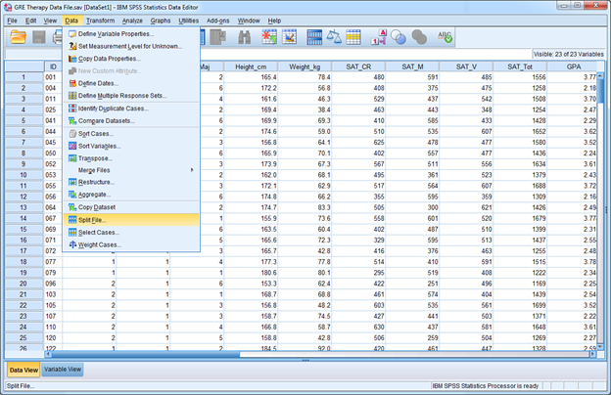
Variability

Slide 4
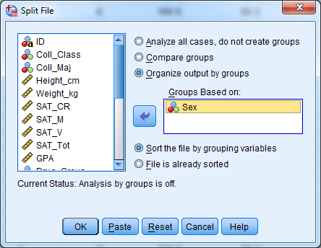
Variability

Slide 5
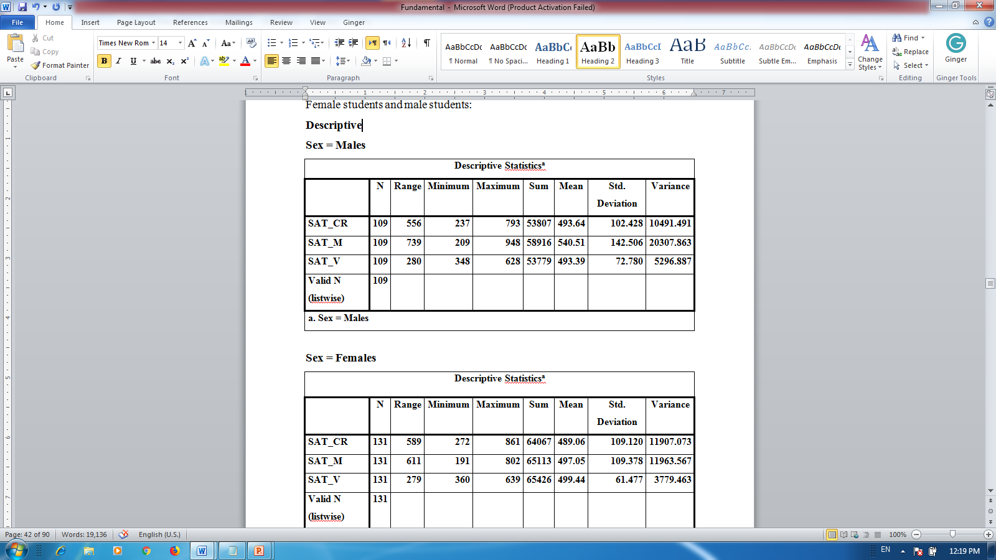
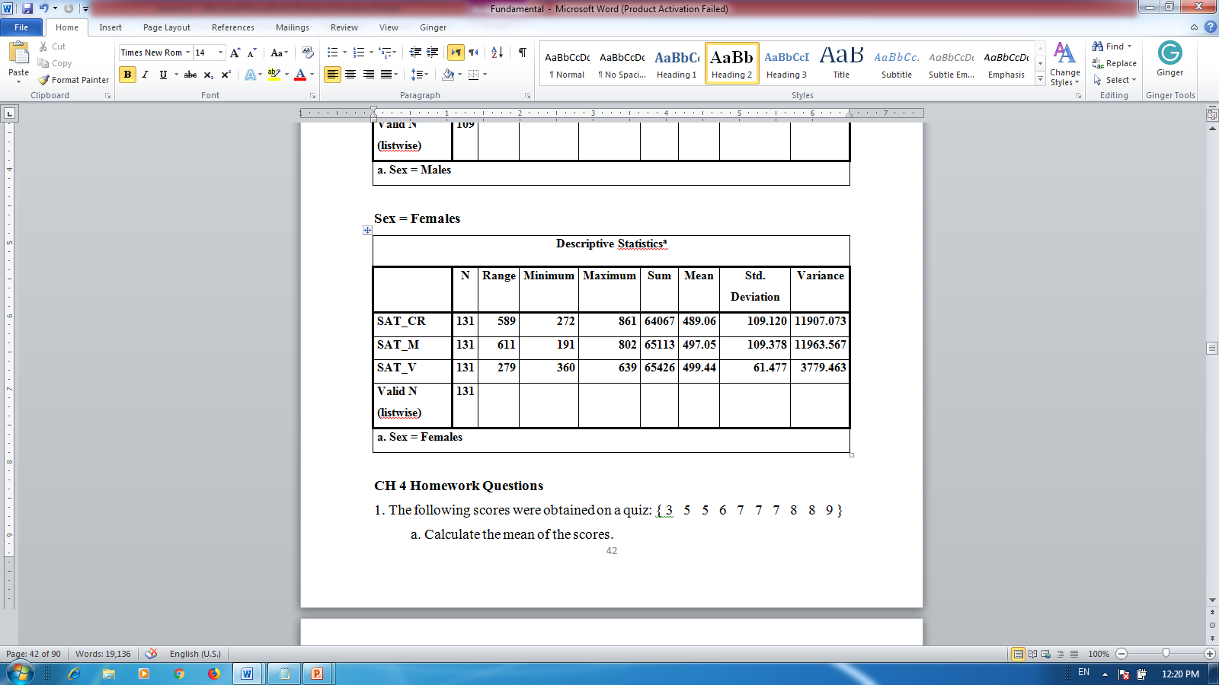
Variability

Slide 6
Correlation
5.1 Relationships between Variables:
The correlation is the statistical association between two variables. A correlation exists when changes in one dependent variable are statistically associated with systematic changes in another variable; hence, a correlation is a type of bivariate relationship, but one where there is no independent variable. This chapter introduces methods for measuring and describing the strength of the relationship between quantitative variables.

Slide 7
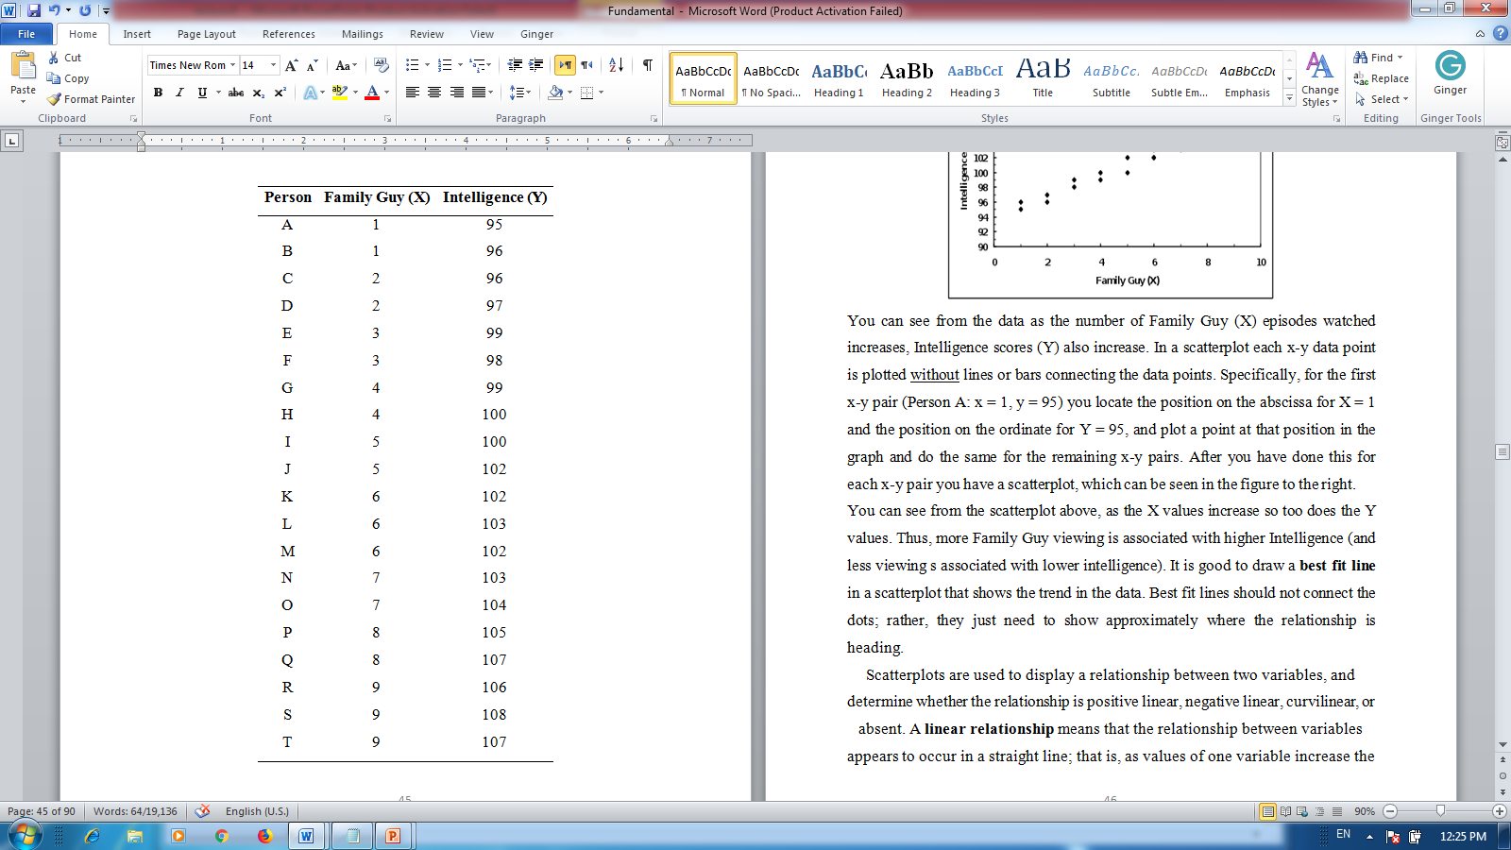
Correlation

Slide 8
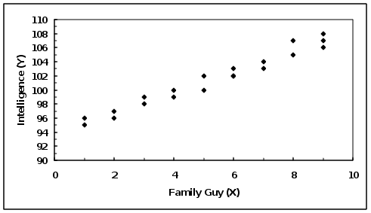
Correlation

Slide 9
Correlation
Scatterplots are used to display a relationship between two variables, and determine whether the relationship is positive linear, negative linear, curvilinear, or absent. A linear relationship means that the relationship between variables appears to occur in a straight line; that is, as values of one variable increase the values of a second variable change in a consistent manner. A curvilinear relationship exists when there is a change or a “bend” in the relationship between variables. For example, as the values of one variable increase the values of the other variable also increase, but at some point the values of the second variable

Slide 10
Correlation
5.3 Pearson Correlation Coefficient:
The statistic most often used to measures the correlation between quantitative variables is the Pearson Product-Moment Correlation Coefficient or, more succinctly, the Pearson correlation (r or rXY). The Pearson correlation is used to measure the strength and direction of a linear relationship between two quantitative variables. The Pearson correlation can be used to measure the relationship between variables if the following conditions are met:

Slide 11
Correlation
5.4 Calculating the Pearson Correlation (r):
The Pearson correlation is defined as standardized covariance between two quantitative variables. What the heck does this mean? The calculate a z-Score, you divide the difference between a raw score and the mean of a distribution by the standard deviation of the distribution. This means that the difference between the raw score and the mean was standardized. The Pearson correlation is calculated by doing something similar. A measure referred to as covariance is divided by the product of two standard deviations; hence, this measure of covariance is standardized. So what is covariance?

